Slide 1

Besser
Christian Childress | Jason Logerquist | Kristade Swain

Slide 2

Focus
Create new employee suggestion system for Zublin
Employees can quickly and easily notify administration about potential new ideas
Any employee (whether blue or white collar) could suggest an idea
Potential Ideas are rated and ranked
Reviewers decide whether or not ideas should continue or end

Slide 3
Sprint 1 - Goal
Our goal for sprint 1 is to get the framework done for the user interface of the app. We plan to get a login working, views for each of the users to complete their workflow, and to display info pulled from the database. We will attempt to get some of the simple functionality for each of the views as well done.

Slide 4
Sprint 1 - Achievements
We successfully created a login page for the application.
We successfully created a registration page for application.
We successfully created backend implementations for these pages.
We successfully created employee and reviewer views with proper implementation and backend.
We successfully created idea view for the application.
We successfully created a list of created ideas on the backend.
We created a dynamic view based on how many list items were grabbed from the database .
We created an overall similar view of the mockup that they wanted us to use for viewing activities.

Slide 5
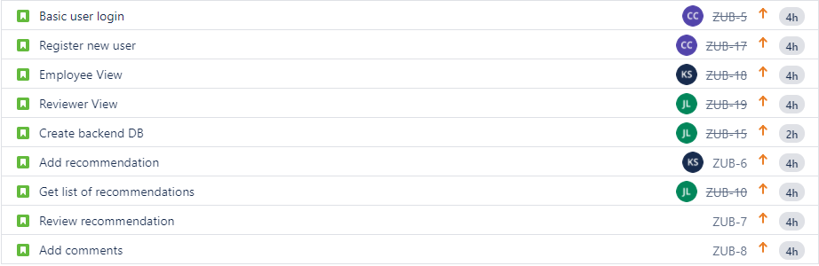
Sprint 1 - Backlog

Slide 6
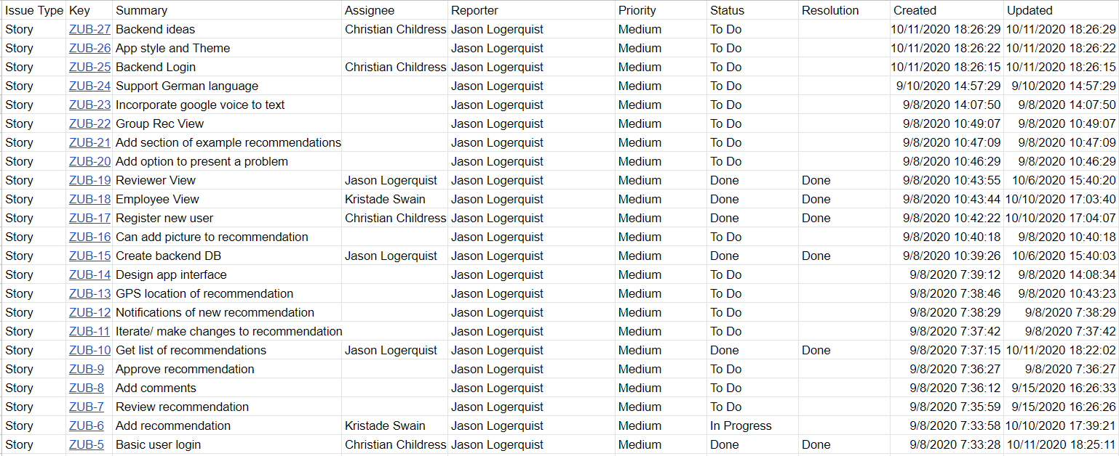
Project - Backlog

Slide 7
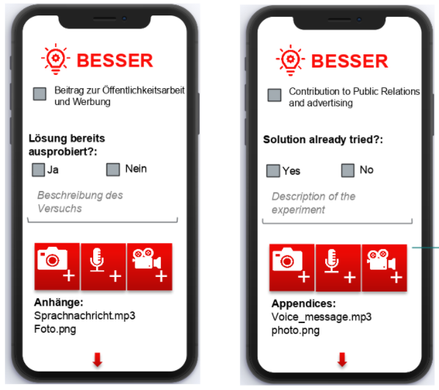
Still Pending...
We did not get to complete some of the features we had hoped for in Sprint 1.
Review Recommendations
Activity for reviewers to review each recommendations.
Add Comments
Activity for reviewers to add comments to recommendations.

Slide 8
A Few Bumps in the Road
Learning the Android app development workflow.
Finding documentation/tutorials for certain features on Android apps, i.e. custom app bar/toolbar.
Implementing a provided mocked up in the Android framework.
Making sure everyone was pushing and pulling their information every time they had questions or had new implementations for a problem.
Learning the certain quirks that are associated with the Java implementation in Android Studio.

Slide 9
Live Demo

